Slide 1


Slide 4
Type | Num Filters / Neurons | Filter / Pool Size | Stride | Activation Function | Dropout
Convolutional | 64 | 8 | 1 | ReLU | -
MaxPooling | - | 8 | 8 | - | -
Convolutional | 32 | 8 | 1 | ReLU | -
Convolutional | 32 | 16 | 1 | ReLU | -
MaxPooling | - | 6 | 6 | - | -
Convolutional | 16 | 16 | 1 | ReLU | -
Convolutional | 16 | 32 | 1 | ReLU | -
MaxPooling | - | 4 | 4 | - | -
Convolutional | 16 | 32 | 1 | ReLU | -
Dense | 64 | - | - | ReLU | 0.5
Dense | 64 | - | - | ReLU | 0.5
Dense | 2 | - | - | SoftMax | -
Input timeseries
Type | Num Filters / Neurons / Heads | Filter / Pool / Head Size / Dense Dimensions | Stride | Activation Function | Dropout
Convolutional | 64 | 8 | 1 | ReLU | -
MaxPooling | - | 8 | 8 | - | -
Convolutional | 32 | 8 | 1 | ReLU | -
Convolutional | 32 | 16 | 1 | ReLU | -
MaxPooling | - | 6 | 6 | - | -
Convolutional | 16 | 16 | 1 | ReLU | -
Convolutional | 16 | 32 | 1 | ReLU | -
MaxPooling | - | 4 | 4 | - | -
Convolutional | 128 | 1 | 1 | ReLU | -
Positional Encoding | - | - | - | - | -
Input timeseries
Multi-Attention Head | 8 | 16 | - | ReLU | -
Dense | 128 | 16 | - | ReLU | 0.5
Dense | 8 | 16 | - | ReLU | 0.5
Binary Classification
×8
Attention Blocks
Dense | 500 | - | - | ReLU | 0.5
Dense | 2 | - | - | SoftMax | -
Type | Num Filters / Neurons / Heads | Filter / Pool / Head Size / Dense Dimensions | Stride | Activation Function | Dropout
Convolutional | 128 | 1 | 1 | ReLU | -
Positional Encoding | - | - | - | - | -
Input timeseries
Binary Classification
Multi-Attention Head | 8 | 16 | - | ReLU | -
Dense | 128 | 16 | - | ReLU | 0.5
Dense | 8 | 16 | - | ReLU | 0.5
×8
Attention Blocks
Dense | 64 | - | - | ReLU | 0.5
Dense | 2 | - | - | SoftMax | -
Binary Classification

Slide 5
Type | Num Filters / Neurons / Heads | Filter / Pool / Head Size / Dense Dimensions | Stride | Activation Function | Dropout
Convolutional | 64 | 8 | 1 | ReLU | -
MaxPooling | - | 8 | 8 | - | -
Convolutional | 32 | 8 | 1 | ReLU | -
Convolutional | 32 | 16 | 1 | ReLU | -
MaxPooling | - | 6 | 6 | - | -
Convolutional | 16 | 16 | 1 | ReLU | -
Convolutional | 16 | 32 | 1 | ReLU | -
MaxPooling | - | 4 | 4 | - | -
Convolutional | 128 | 1 | 1 | ReLU | -
Positional Encoding | - | - | - | - | -
Input timeseries
Multi-Attention Head | 8 | 16 | - | ReLU | -
Dense | 128 | 16 | - | ReLU | 0.5
Dense | 8 | 16 | - | ReLU | 0.5
×8
Attention Blocks
Dense | 500 | - | - | ReLU | 0.5
Dense | 2 | - | - | SoftMax | -
Binary Classification
Type | Num Filters / Neurons | Filter / Pool Size | Stride | Activation Function | Dropout
Convolutional | 64 | 8 | 1 | ReLU | -
MaxPooling | - | 8 | 8 | - | -
Convolutional | 32 | 8 | 1 | ReLU | -
Convolutional | 32 | 16 | 1 | ReLU | -
MaxPooling | - | 6 | 6 | - | -
Convolutional | 16 | 16 | 1 | ReLU | -
Convolutional | 16 | 32 | 1 | ReLU | -
MaxPooling | - | 4 | 4 | - | -
Convolutional | 16 | 32 | 1 | ReLU | -
Dense | 64 | - | - | ReLU | 0.5
Dense | 64 | - | - | ReLU | 0.5
Dense | 2 | - | - | SoftMax | -
Binary Classification

Slide 6
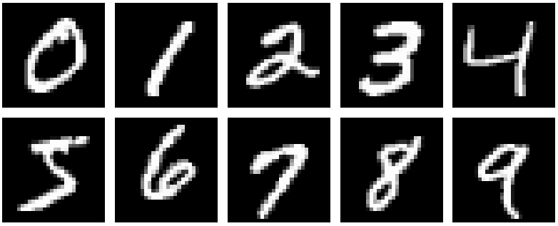
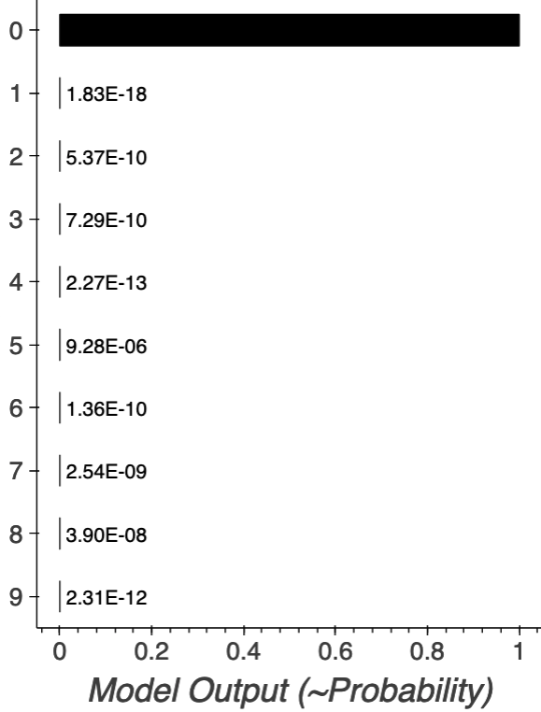
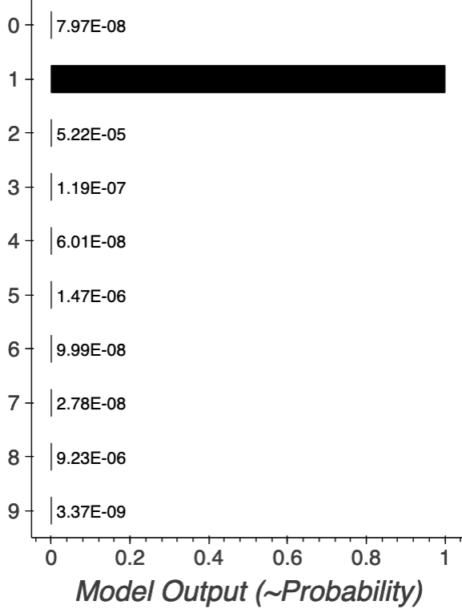
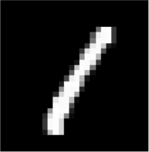
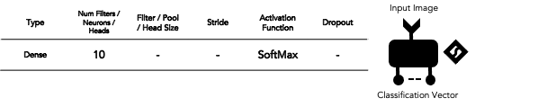
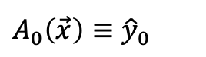

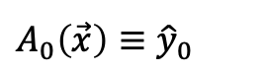
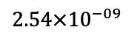
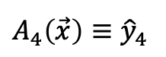
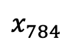
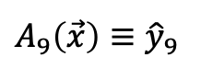
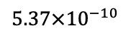
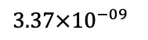
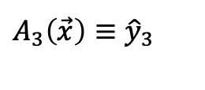
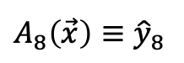
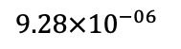

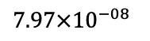
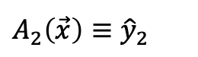
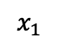
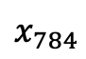
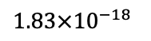
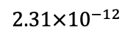
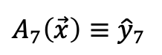
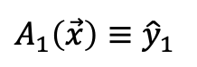
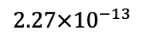
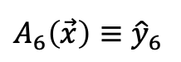
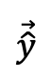
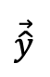
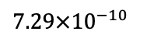
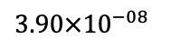
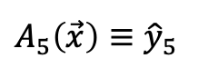
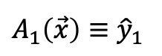
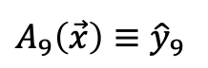
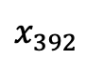
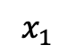
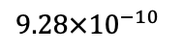

…
$x_{1}$
$$A_{0}\left(\vec{x}\right)≡{\hat{y}}_{0}$$
$$1.00×{10}^{+00}$$
$$A_{1}\left(\vec{x}\right)≡{\hat{y}}_{1}$$
$$1.83×{10}^{−18}$$
$$A_{2}\left(\vec{x}\right)≡{\hat{y}}_{2}$$
$$5.37×{10}^{−10}$$
$$A_{3}\left(\vec{x}\right)≡{\hat{y}}_{3}$$
$$7.29×{10}^{−10}$$
$$1.00×{10}^{00}$$
flatten
$$x_{392}$$
$$A_{4}\left(\vec{x}\right)≡{\hat{y}}_{4}$$
$$2.27×{10}^{−13}$$
$$\vec{\hat{y}}$$
$$A_{5}\left(\vec{x}\right)≡{\hat{y}}_{5}$$
$$9.28×{10}^{−06}$$
$$A_{6}\left(\vec{x}\right)≡{\hat{y}}_{6}$$
$$9.28×{10}^{−10}$$
…
$$A_{7}\left(\vec{x}\right)≡{\hat{y}}_{7}$$
$$2.54×{10}^{−09}$$
$$A_{8}\left(\vec{x}\right)≡{\hat{y}}_{8}$$
$$3.90×{10}^{−08}$$
$$x_{784}$$
$$A_{9}\left(\vec{x}\right)≡{\hat{y}}_{9}$$
$$2.31×{10}^{−12}$$
…
$x_{1}$
$$A_{0}\left(\vec{x}\right)≡{\hat{y}}_{0}$$
$$7.97×{10}^{−08}$$
flatten
$$A_{1}\left(\vec{x}\right)≡{\hat{y}}_{1}$$
$$1.00×{10}^{+00}$$
$$\vec{\hat{y}}$$
…
$$x_{784}$$
$$A_{9}\left(\vec{x}\right)≡{\hat{y}}_{9}$$
$$3.37×{10}^{−09}$$
Type | Num Filters / Neurons / Heads | Filter / Pool / Head Size | Stride | Activation Function | Dropout
Dense | 10 | - | - | SoftMax | -
Input Image
Classification Vector

Slide 7
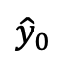
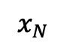
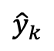
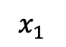

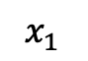
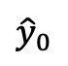
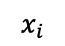


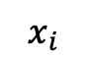


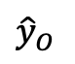
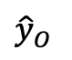
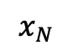
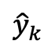

$x_{1}$
$$A_{1}$$
$${\hat{y}}_{0}$$
$x_{1}$
$$A_{1}$$
$${\hat{y}}_{0}$$
$$x_{i}$$
$$A_{j}$$
$${\hat{y}}_{k}$$
$$x_{i}$$
$$A_{j}$$
$${\hat{y}}_{k}$$
$$x_{N}$$
$$A_{H}$$
$${\hat{y}}_{O}$$
$$x_{N}$$
$$A_{H}$$
$${\hat{y}}_{O}$$
Type | Num Filters / Neurons | Filter / Pool Size | Stride | Activation Function | Dropout
Whitening | - | - | - | - | -
Dense | 1 | - | - | SoftMax | -
off-source
on-source
Binary Classification
Type | Num Filters / Neurons | Filter / Pool Size | Stride | Activation Function | Dropout
Whitening | - | - | - | - | -
Dense | 64/128/256 | - | - | ReLU | -
Dense | 1 | - | - | SoftMax | -
off-source
on-source
Binary Classification
Type | Num Filters / Neurons | Filter / Pool Size | Stride | Activation Function | Dropout
Whitening | - | - | - | - | -
Dense | 64/128/256 | - | - | ReLU | -
Dense | 64/128/256 | - | - | ReLU | -
Dense | 1 | - | - | SoftMax | -
off-source
on-source
Binary Classification
Type | Num Filters / Neurons | Filter / Pool Size | Stride | Activation Function | Dropout
Whitening | - | - | - | - | -
Dense | 64/128/256 | - | - | ReLU | -
Dense | 64/128/256 | - | - | ReLU | -
Dense | 64/128/256 | - | - | ReLU | -
Dense | 1 | - | - | SoftMax | -
off-source
on-source
Binary Classification

Slide 8
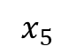
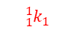















































Type | Num Filters / Neurons | Filter / Pool Size | Stride | Activation Function | Dropout
Convolutional | 3 | 3 | 1 | ReLU | -
Convolutional | 2 | 2 | 1 | ReLU | -
Dense | 3 | - | - | ReLU | -
Dense | 2 | - | - | SoftMax | -
1D input vector
binary classification
vector
Type | Num Filters / Neurons | Filter / Pool Size | Stride | Activation Function | Dropout
Convolutional | 3 | 3 | 1 | ReLU | -
Convolutional | 2 | 2 | 1 | ReLU | -
1D input vector
other layers
$x_{1}$
$${}_{1}^{1}{k_{1}}$$
Type | Num Filters / Neurons | Filter / Pool Size | Stride | Activation Function | Dropout
Convolutional | 3 | 3 | 1 | ReLU | -
1D input vector
$x_{2}$
$x_{3}$
$${}_{1}^{1}{k_{2}}$$
$x_{4}$
other layers
$x_{5}$
$${}_{1}^{1}{k_{3}}$$
$x_{1}$
$${}_{1}^{1}{k_{1}}$$
$x_{1}$
$${}_{1}^{1}{k_{1}}$$
$x_{2}$
$${}_{2}^{1}{k_{1}}$$
$${}_{3}^{1}{k_{1}}$$
$x_{2}$
$${}_{2}^{1}{k_{1}}$$
$${}_{1}^{2}{k_{1}}$$
$x_{3}$
$${}_{1}^{1}{k_{2}}$$
$${}_{2}^{1}{k_{2}}$$
$x_{3}$
$${}_{1}^{1}{k_{2}}$$
$${}_{3}^{1}{k_{1}}$$
$${}_{2}^{2}{k_{1}}$$
$x_{4}$
$${}_{3}^{1}{k_{2}}$$
$x_{4}$
$${}_{2}^{1}{k_{2}}$$
$${}_{3}^{1}{k_{2}}$$
$${}_{1}^{2}{k_{2}}$$
$x_{5}$
$${}_{1}^{1}{k_{3}}$$
$${}_{2}^{1}{k_{3}}$$
$x_{5}$
$${}_{1}^{1}{k_{3}}$$
$${}_{2}^{2}{k_{2}}$$
$${}_{3}^{1}{k_{3}}$$
$${}_{2}^{1}{k_{3}}$$
$${}_{3}^{1}{k_{3}}$$
flattening layer
(parameter-free rearrangement)
$x_{1}$
$${}_{1}^{1}{k_{1}}$$
$${}_{1}^{2}{k_{1}}$$
$x_{2}$
$${}_{2}^{1}{k_{1}}$$
$${}_{3}^{1}{k_{1}}$$
$${}_{1}^{2}{k_{1}}$$
$${}_{1}^{2}{k_{2}}$$
$${\hat{y}}_{0}$$
$x_{3}$
$${}_{1}^{1}{k_{2}}$$
$${}_{2}^{1}{k_{2}}$$
$${}_{2}^{2}{k_{1}}$$
$x_{4}$
$${}_{3}^{1}{k_{2}}$$
$${}_{1}^{2}{k_{2}}$$
$${}_{2}^{2}{k_{1}}$$
$${\hat{y}}_{1}$$
$x_{5}$
$${}_{1}^{1}{k_{3}}$$
$${}_{2}^{1}{k_{3}}$$
$${}_{2}^{2}{k_{2}}$$
$${}_{2}^{2}{k_{2}}$$
$${}_{3}^{1}{k_{3}}$$
2 convolutional layers
2 dense layers
(dimensionality lost)

Slide 11
v
v

